Slide 1
Hour 10
Creating Your First Object

Slide 2
Review

Slide 3
Review
Keywords
break
case
class
continue
default
do
else
extends
final
if
import
loop
public
static
switch
void
while
Special characters
( )
{ }
[ ]
Operators
= - assignment
+ - add/concatenate
- - subtract
* - multiply
/ - divide
% - modulus
++ - increment
-- - decrement
+= - increment assign
? : - conditional/tenary
Types
boolean
byte
char
double
float
Graphics
int
long
short
String
API Calls
Double.parseDouble()
Graphics.drawString()
Integer.parseInt()
Math.sqrt()
String.equals()
String.indexOf()
String.length()
String.toLowerCase()
String.toUpperCase()
System.out.print()
System.out.println()

Slide 4
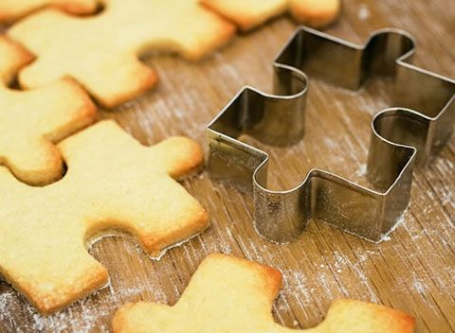
How Object-Oriented Programming Works
In OOP, a computer program is a group objects that interact with each other
Objects have:
Attributes: describes the object
Behaviors: what the object can do
Classes are templates for objects
Like a cookie cutter is the template for cookies

Slide 5
Objects in Action
See Horse example

Slide 6
What Objects Are
See Horse example

Slide 7


Understanding Inheritance
Inheritance is part of OOP
Inheritance allows one class of object to inherit attributes and behavior from a “parent” class
“is-a” relationship
Example
KitKat “is-a” Candy
Reeses “is-a” Candy
CandyBar

Slide 8

Building an Inheritance Hierarchy
Code can be passed down from one class to another
Inheritance hierarchies can be quite large!
Food
Candy
Vegetable
CandyBar

Slide 9
Homework
Change your SecretWord program so that:
The array of secret words is a class member variable
The randomly-selected index is a class member variable
The constructor randomly selects the index of the secret word
The main function calls the SecretWord constructor
The member function “boolean guess()” is called in main to compare the user’s guess with the answer
When the users guesses incorrectly, the program give you one of 3 hints:
Tell the user how many letters are in the word, or
Tell the user the first letter in the word, or
Tell the user the last letter in the word

Slide 10
Converting Objects and Simple Variables
Casting is used to convert from one type of data to another
Casting Simple Variables

Slide 11
Converting Objects and Simple Variables
Casting Objects

Slide 12
Converting Objects and Simple Variables
Converting Simple Variables to Objects and Back

Slide 13
Converting Objects and Simple Variables
Autoboxing and Unboxing

Slide 14
Creating an Object

Slide 15
Summary

